Slide 1

Software I - inFORMed geometries
Mesh Exporations
IaaC, 18/11/2021
Faculty: Andrea Graziano
Assistant: Eugenio Bettucchi
Tomás Quijano
Robert Michael Blackburn
MRAC
Master in Robotics and Advanced Construction
Notes:
This is the cover template
You might change just the title and the team members names (do not change fonts or colors here)
In case you collect some videos together in a longer one, use this as introductory image (5 seconds)

Slide 2
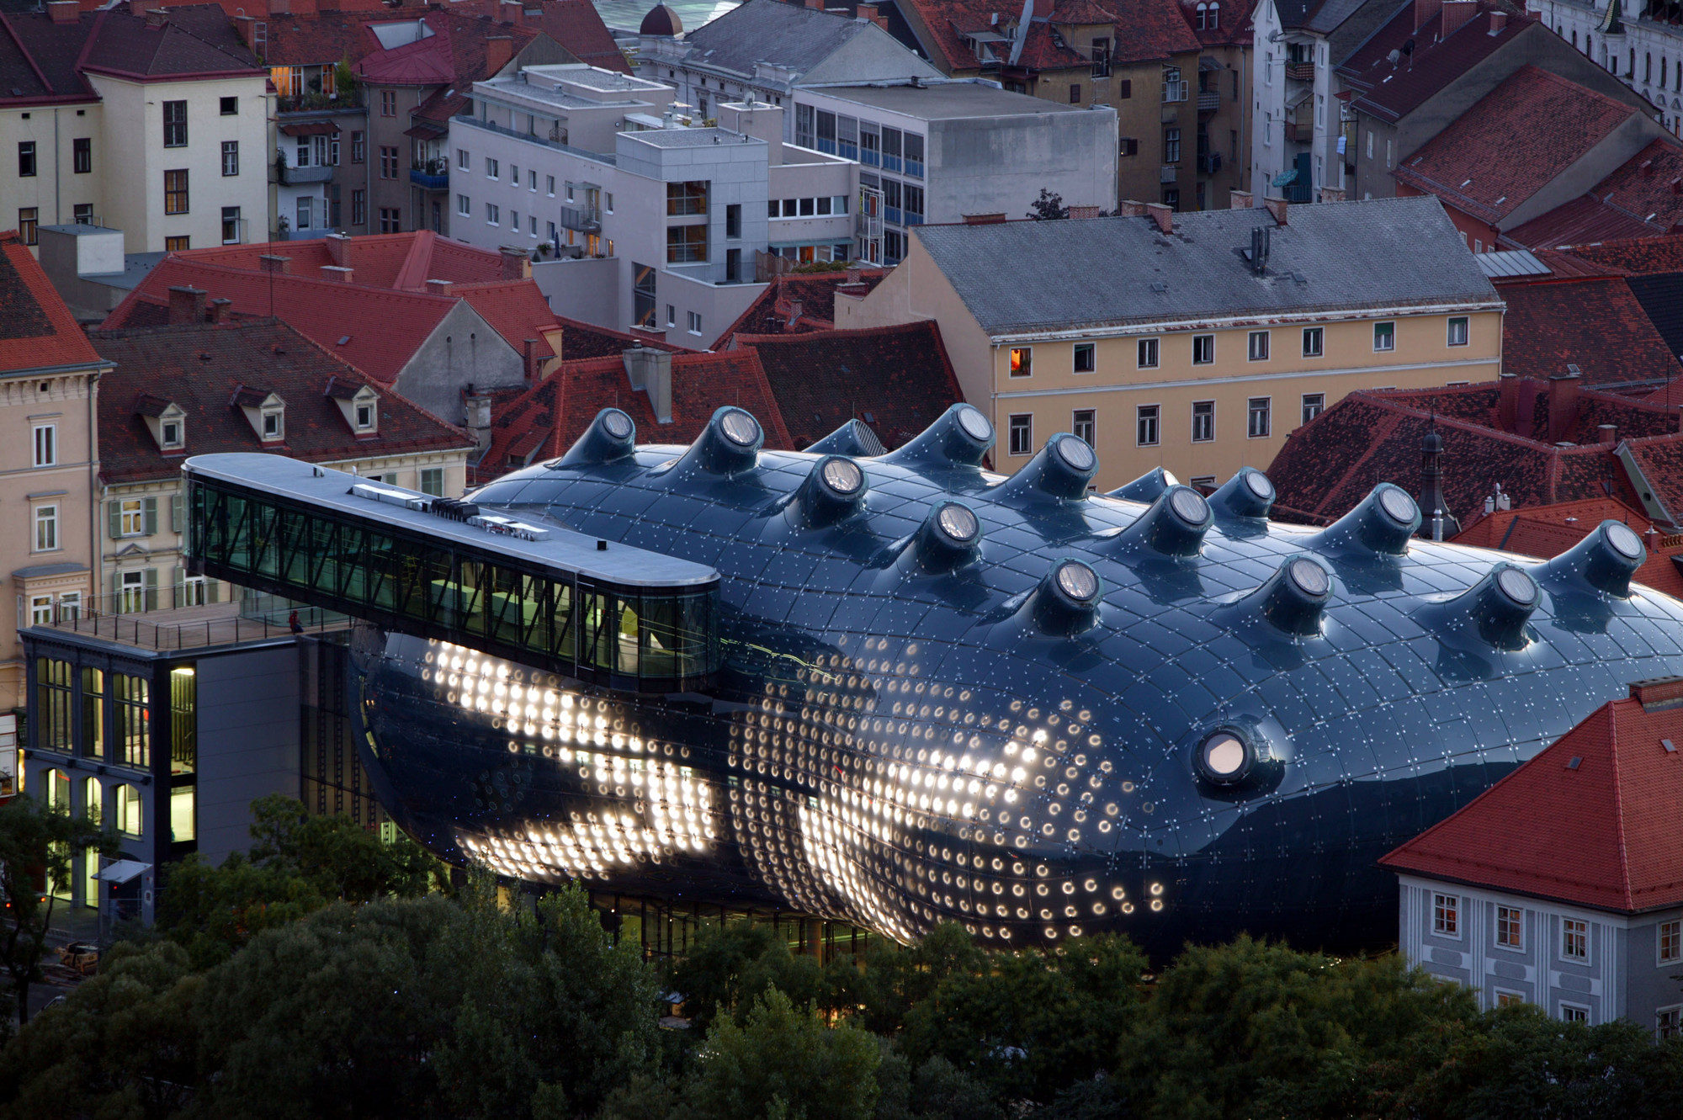
Kunsthaus Graz, Peter Cook

Slide 3
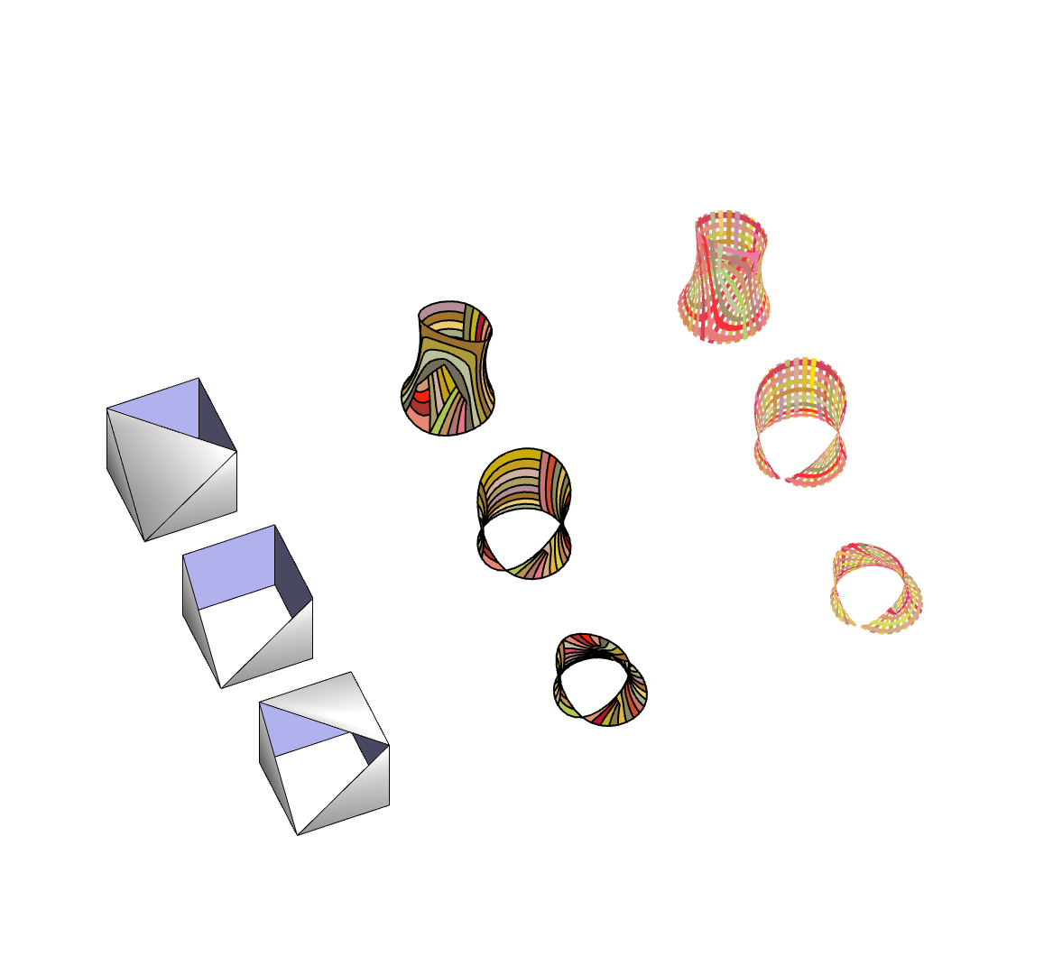
Initial Iterations
Mesh Smoothing
Single Cube Openings, no surrounding mesh

Slide 4
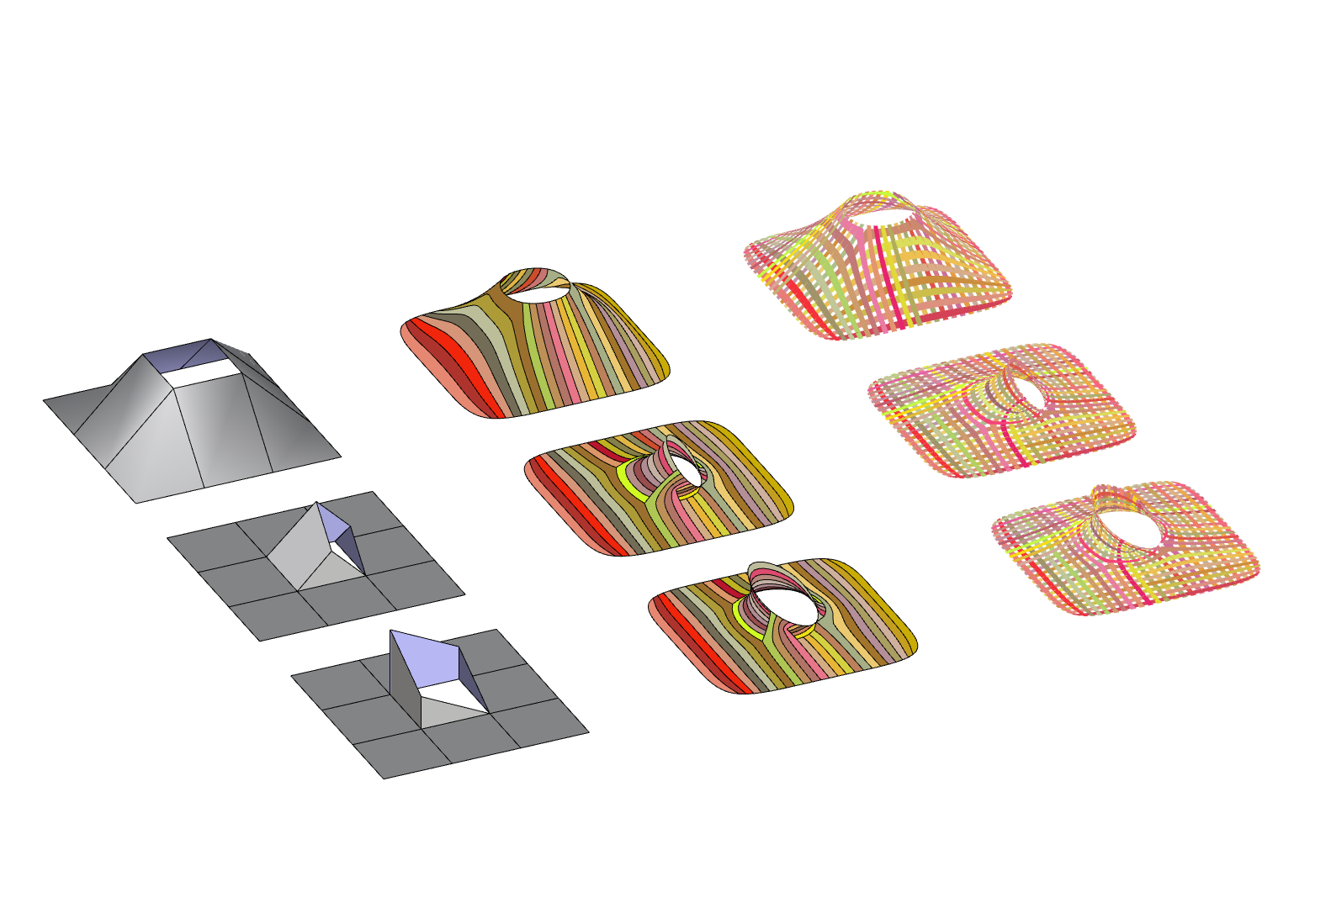
Initial Iterations
Mesh Smoothing
Single Openings, 3x3 Grid

Slide 5
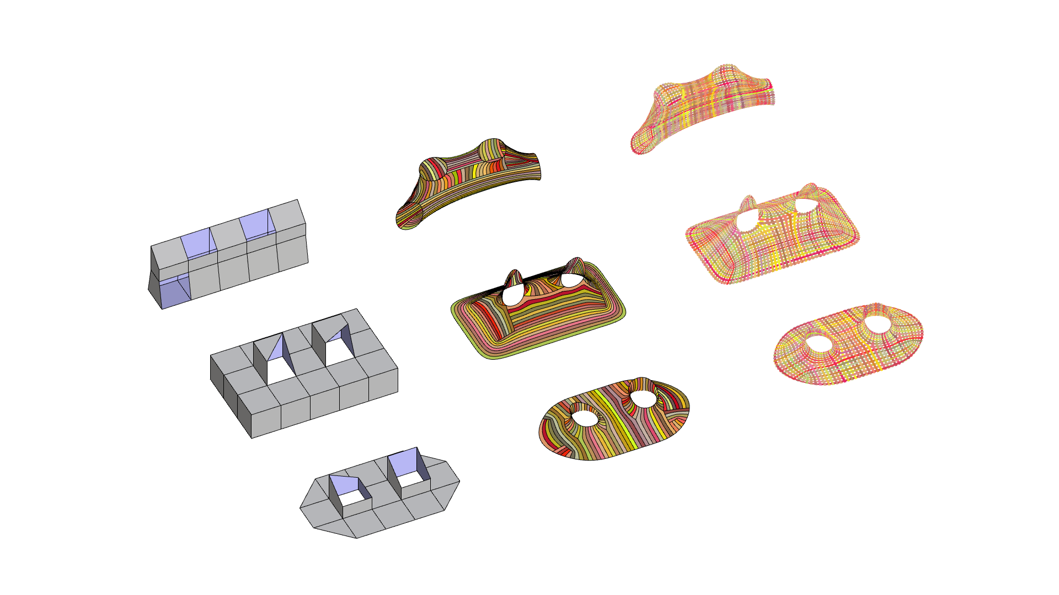
Initial Iterations
Mesh Smoothing
Two Openings, 5x Grid

Slide 6
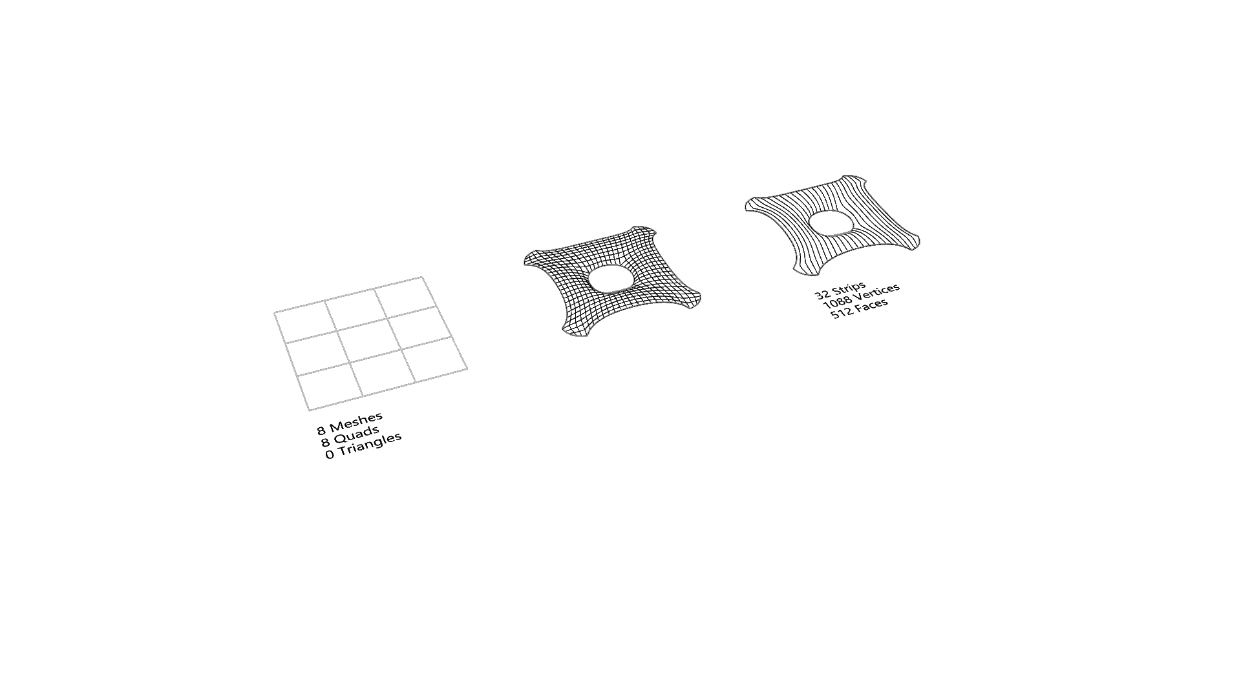
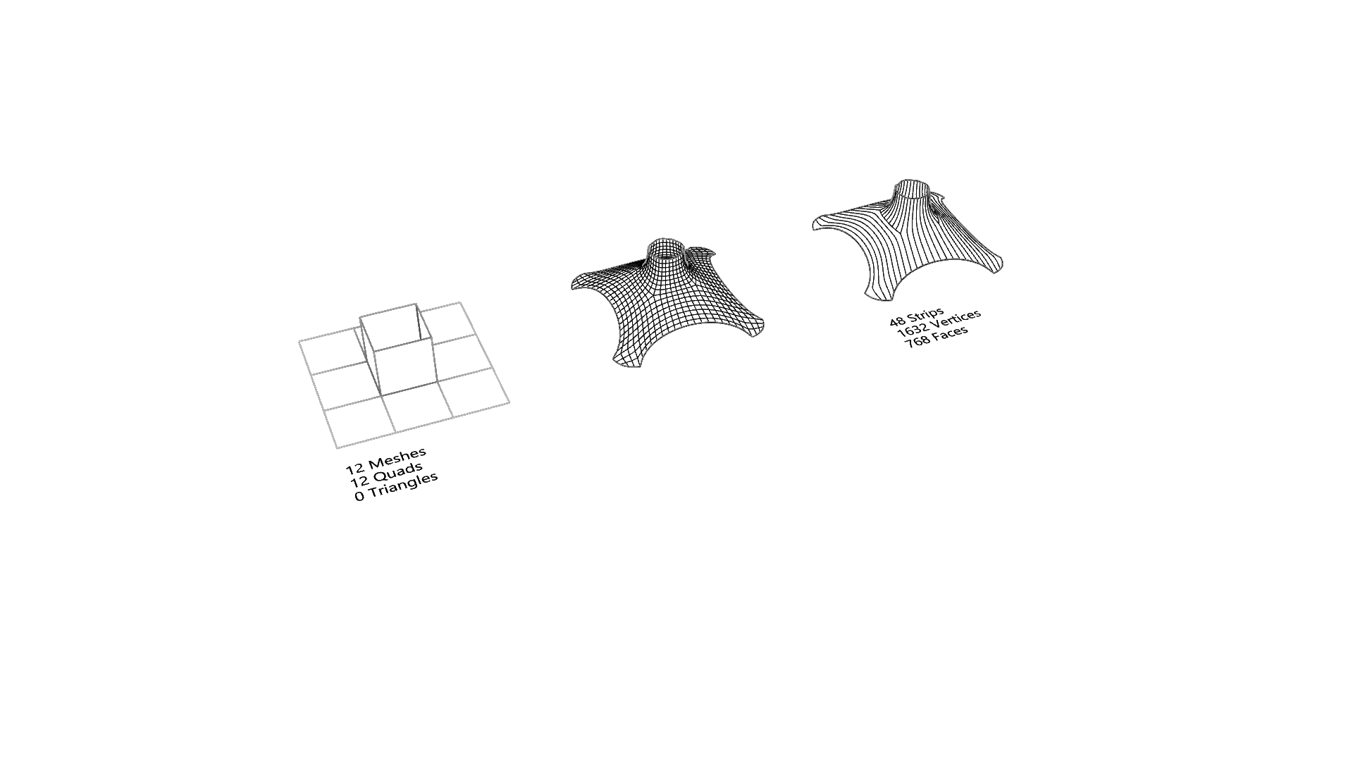
Second Iteration - Relaxation
1 Innie
1 Outie

Slide 7
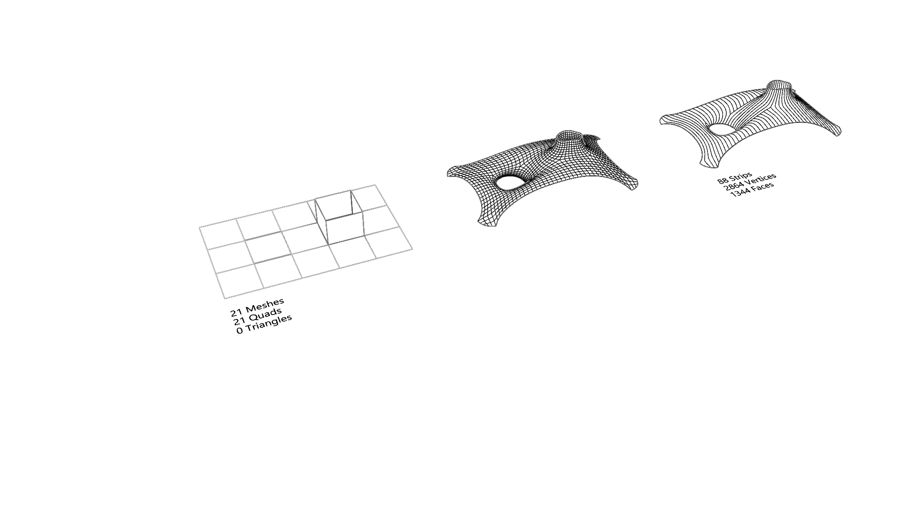
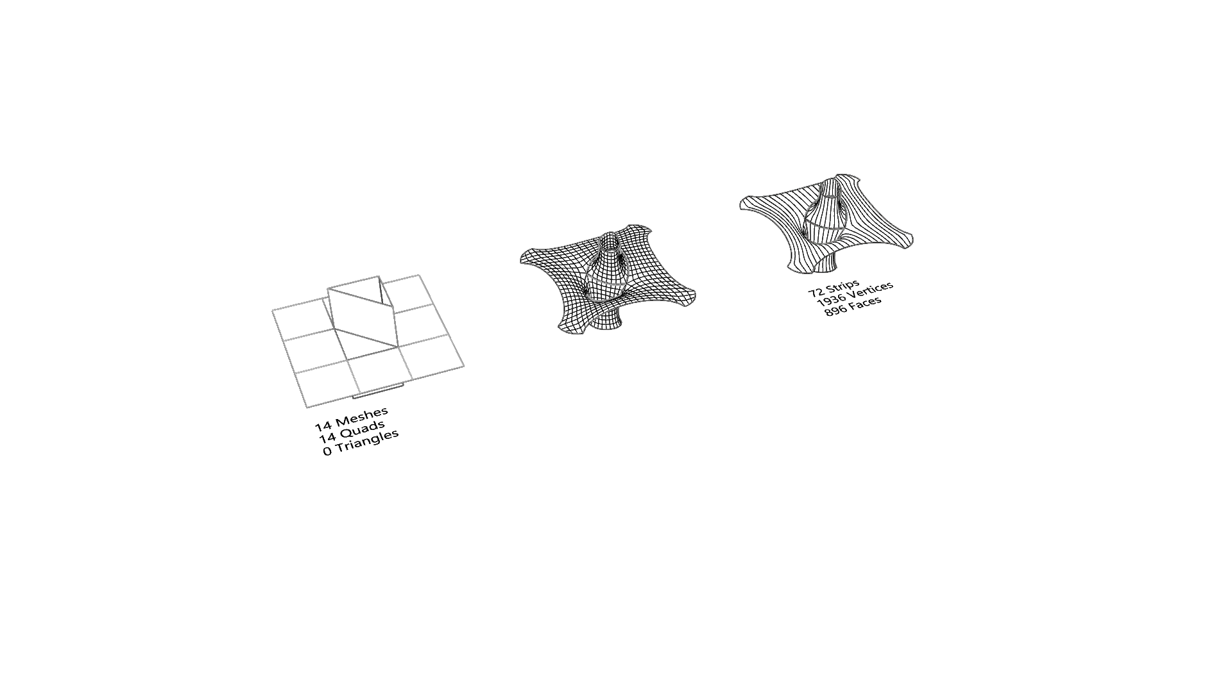
Second Iteration - Relaxation
1 Innie, 1 Outie
Quad Holes Offset
1 Innie, 1 Outie,
Neighboring tri openings

Slide 8
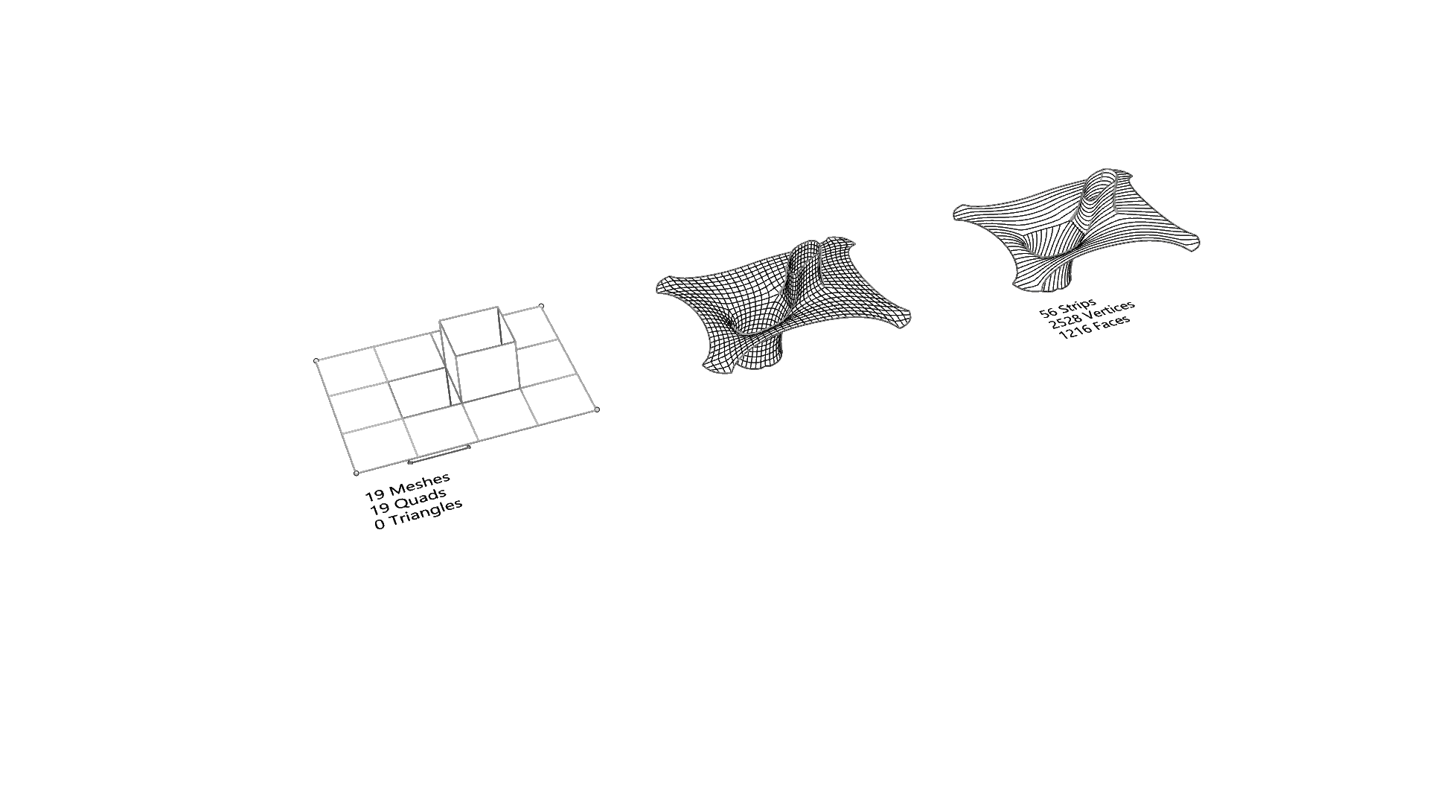
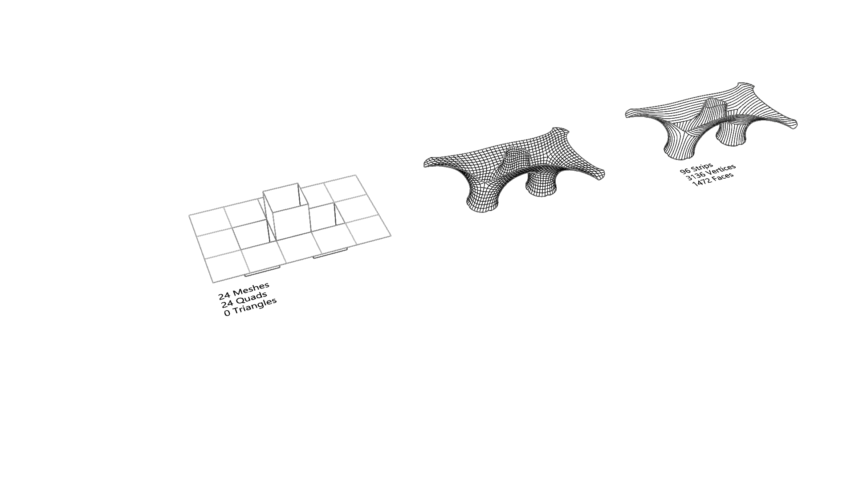
Second Iteration - Relaxation
1 Innie, 1 Outie
Neighboring quad openings
2 Innie, 1 Outie, Neighboring quad openings

Slide 9
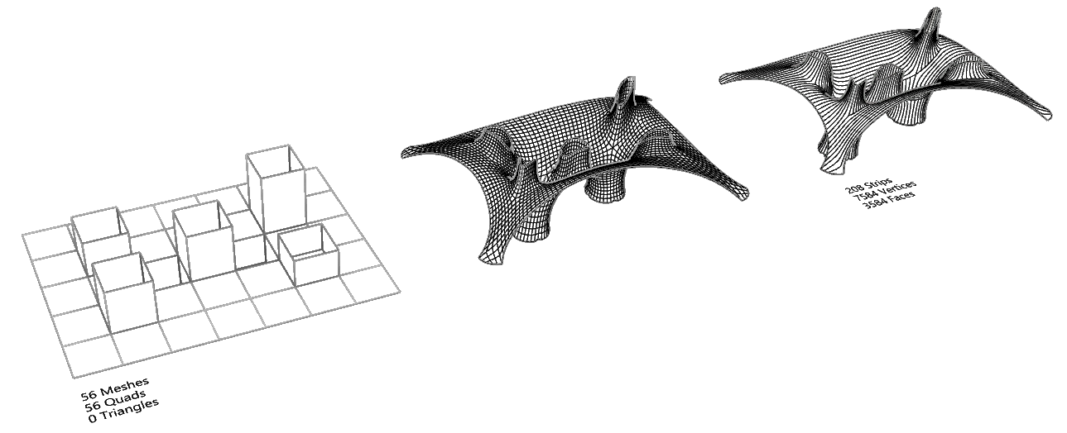
Second Iteration - Relaxation
2 Innie, 5 Outie
Offset Openings
Random Heights

Slide 10
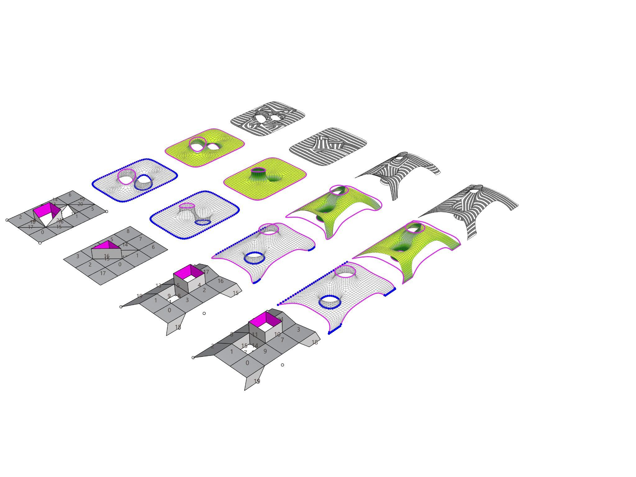
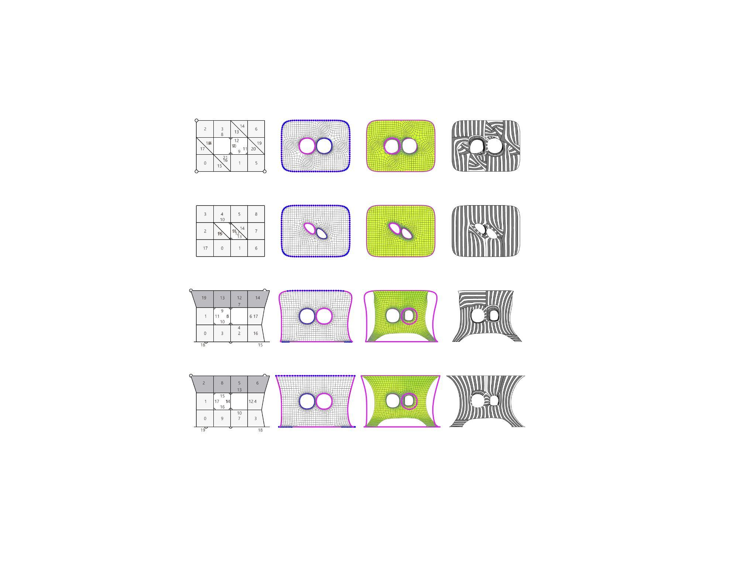
Mesh Relaxation & Anchor points
flat mesh with naked edges
& arched mesh with naked edges
Smooth naked edges & corners
Smooth naked deges

Slide 11
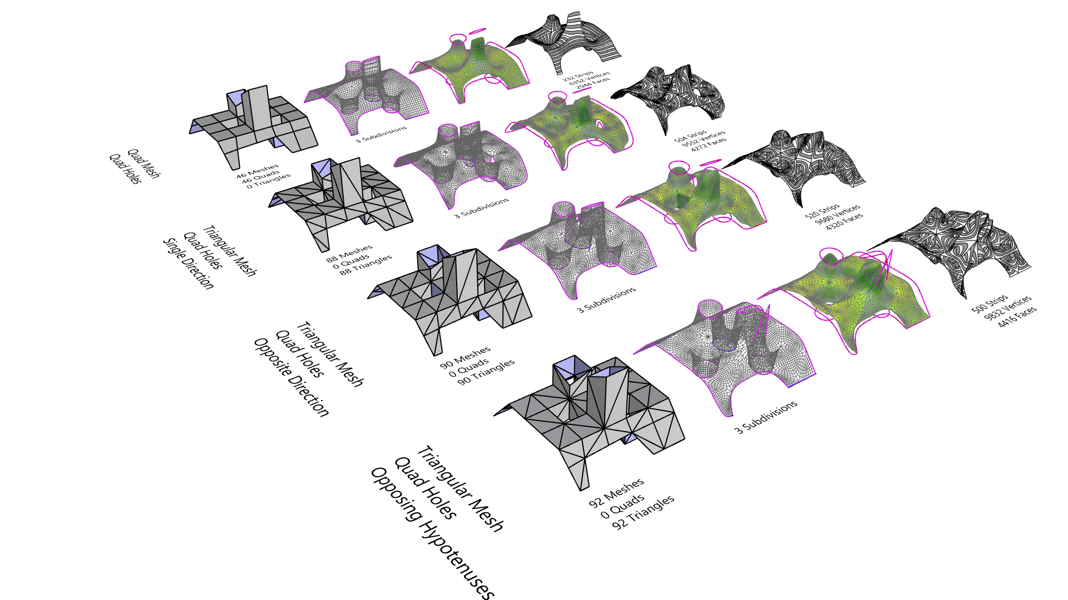
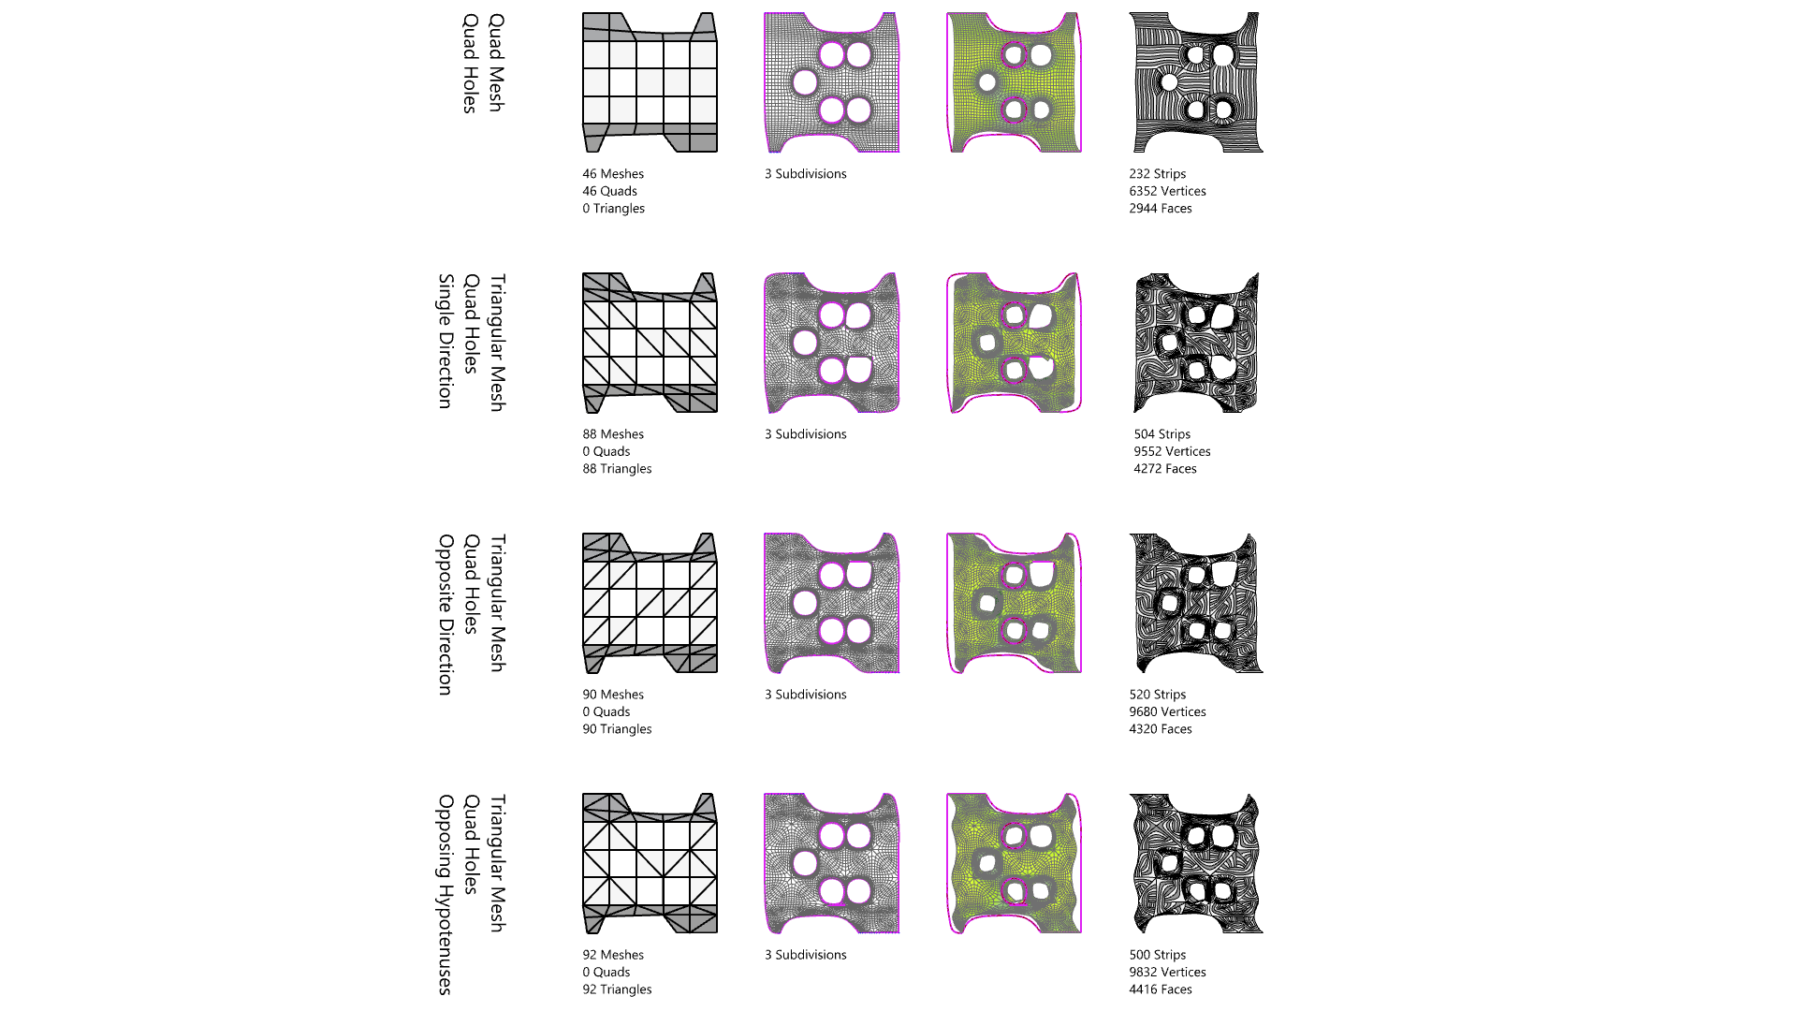
Relaxed Mesh with Innies & Outies
Triangulation Study

Slide 12
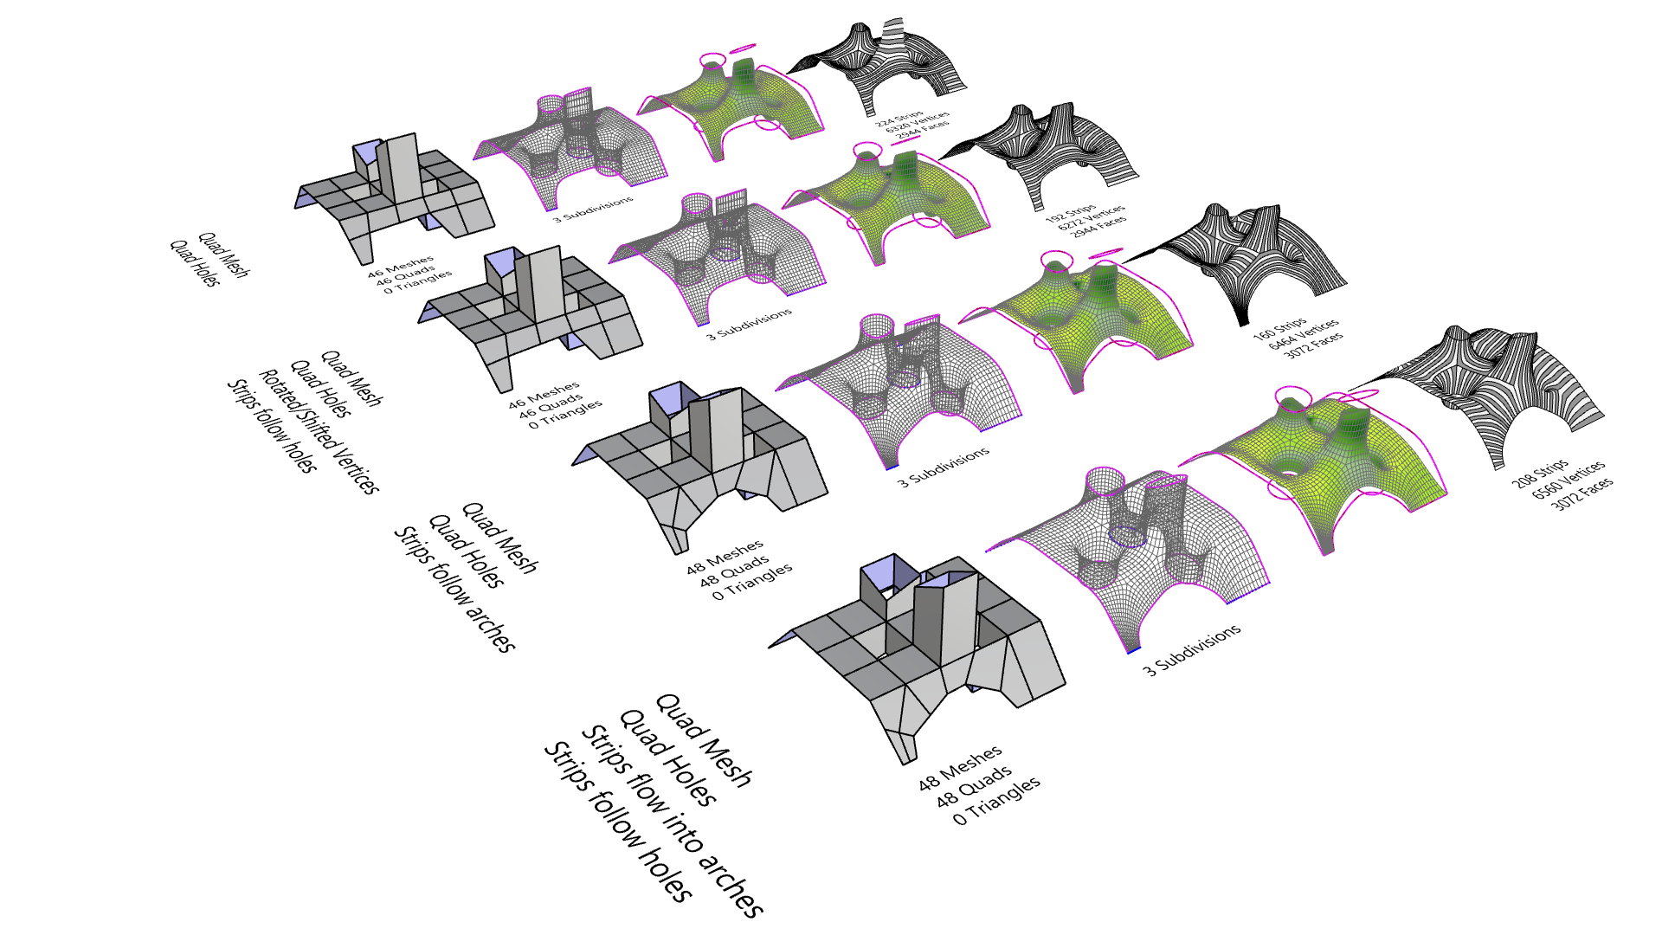
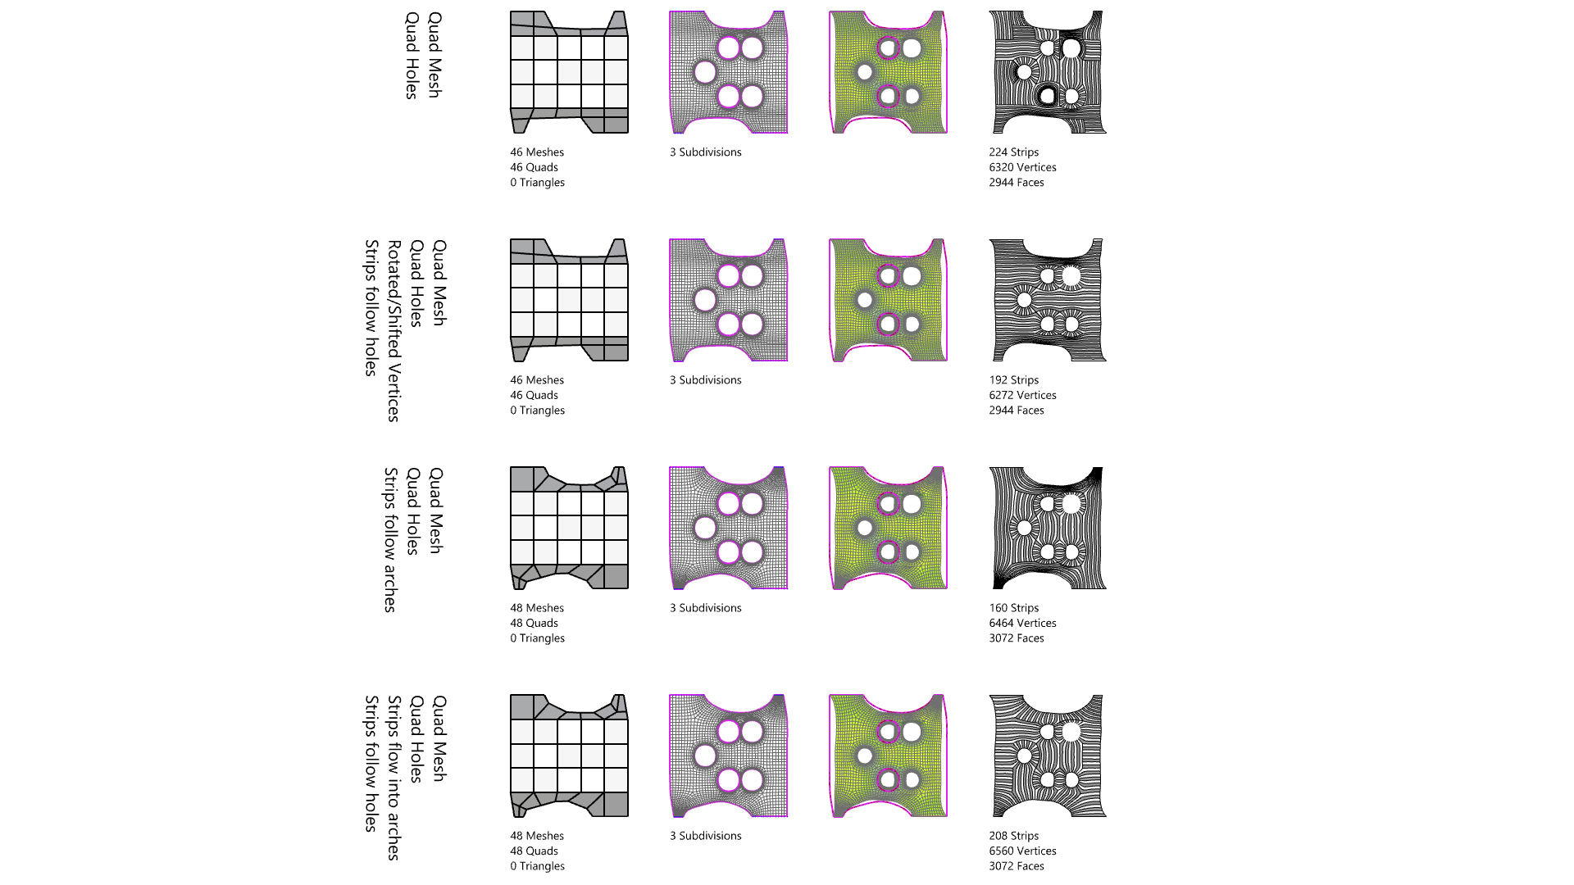
Relaxed Mesh with Innies & Outies
Quads Study
Mesh Orientation Study

Slide 13
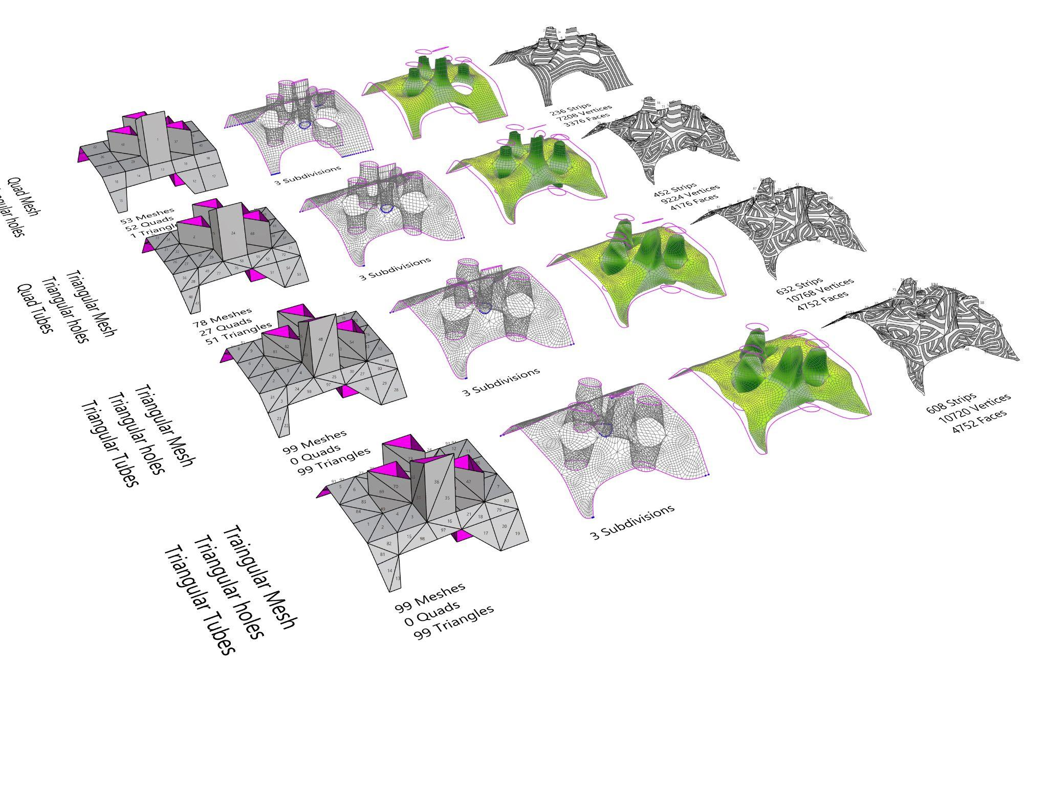
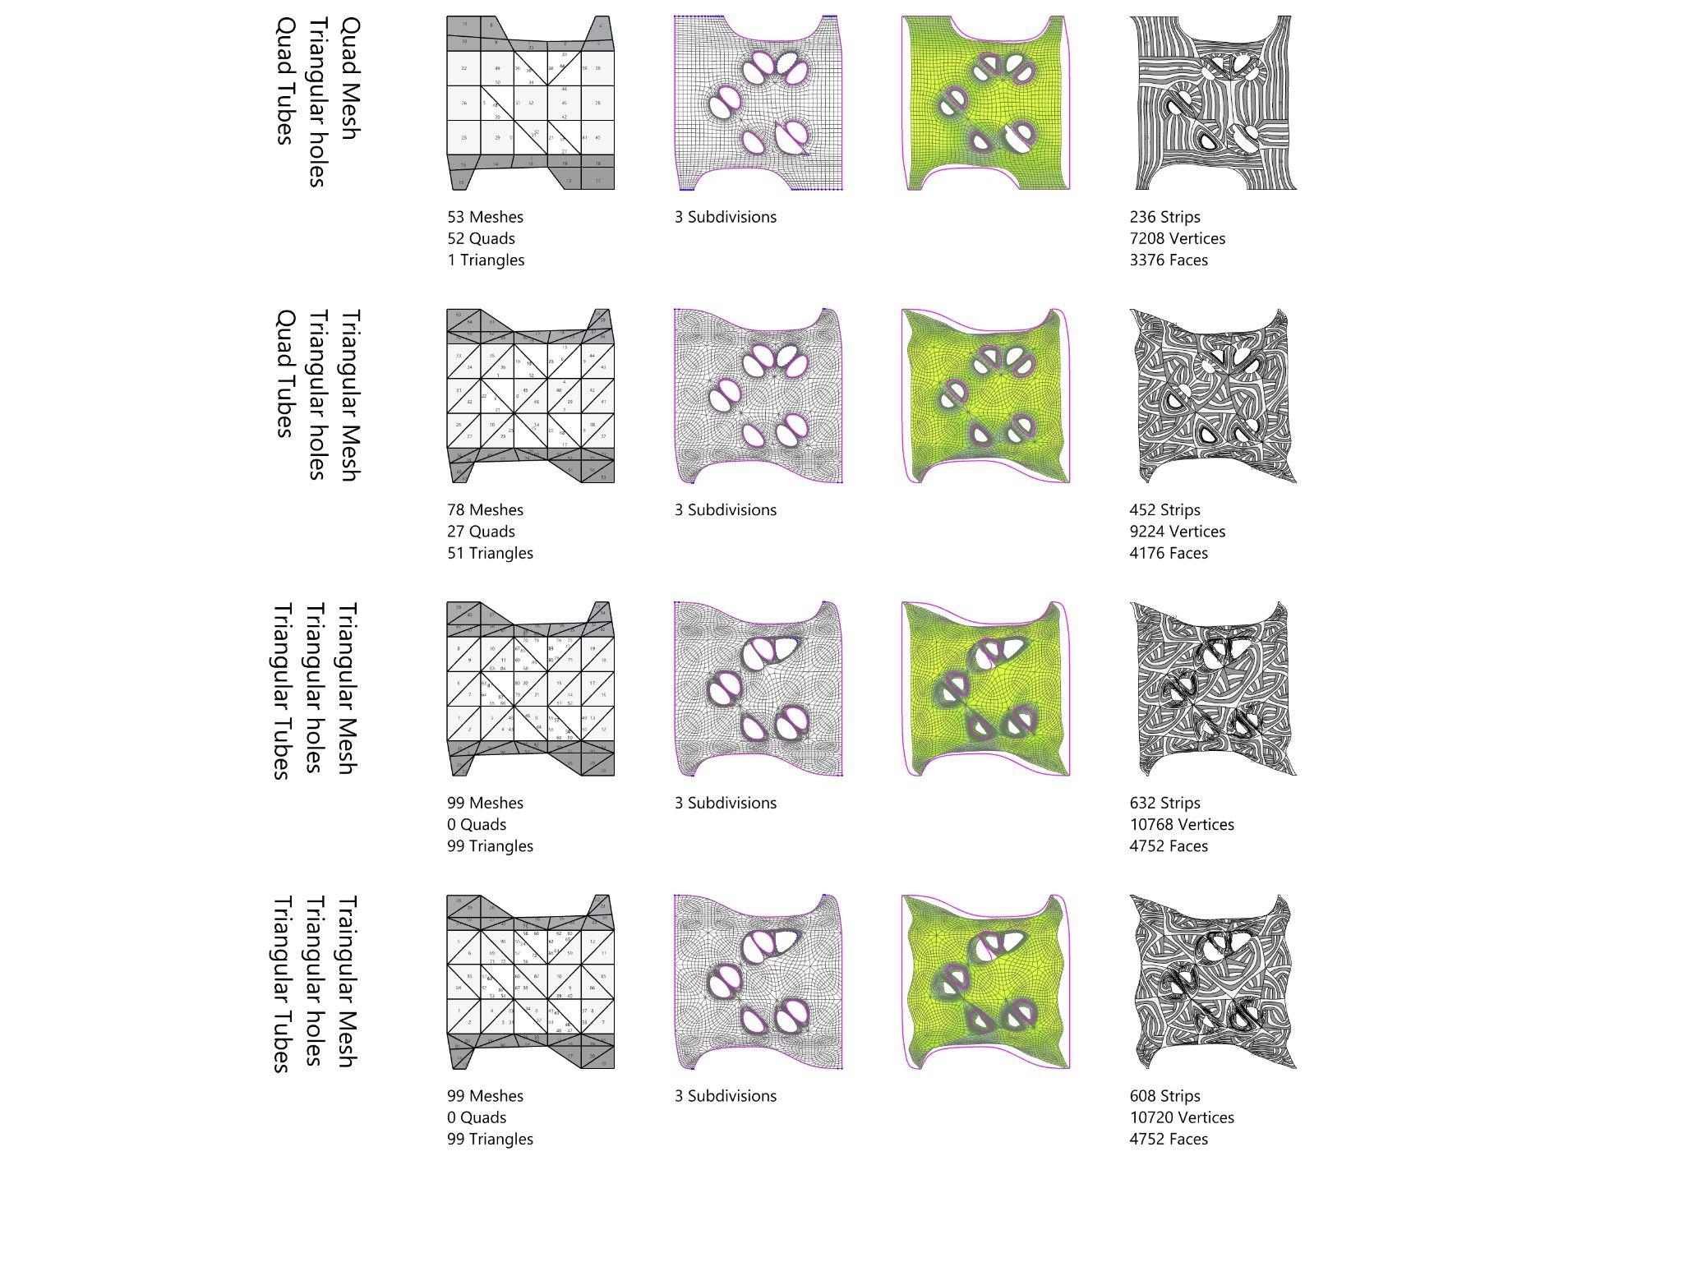
Relaxed Mesh with Innies & Outies
Triangulation Study

Slide 14

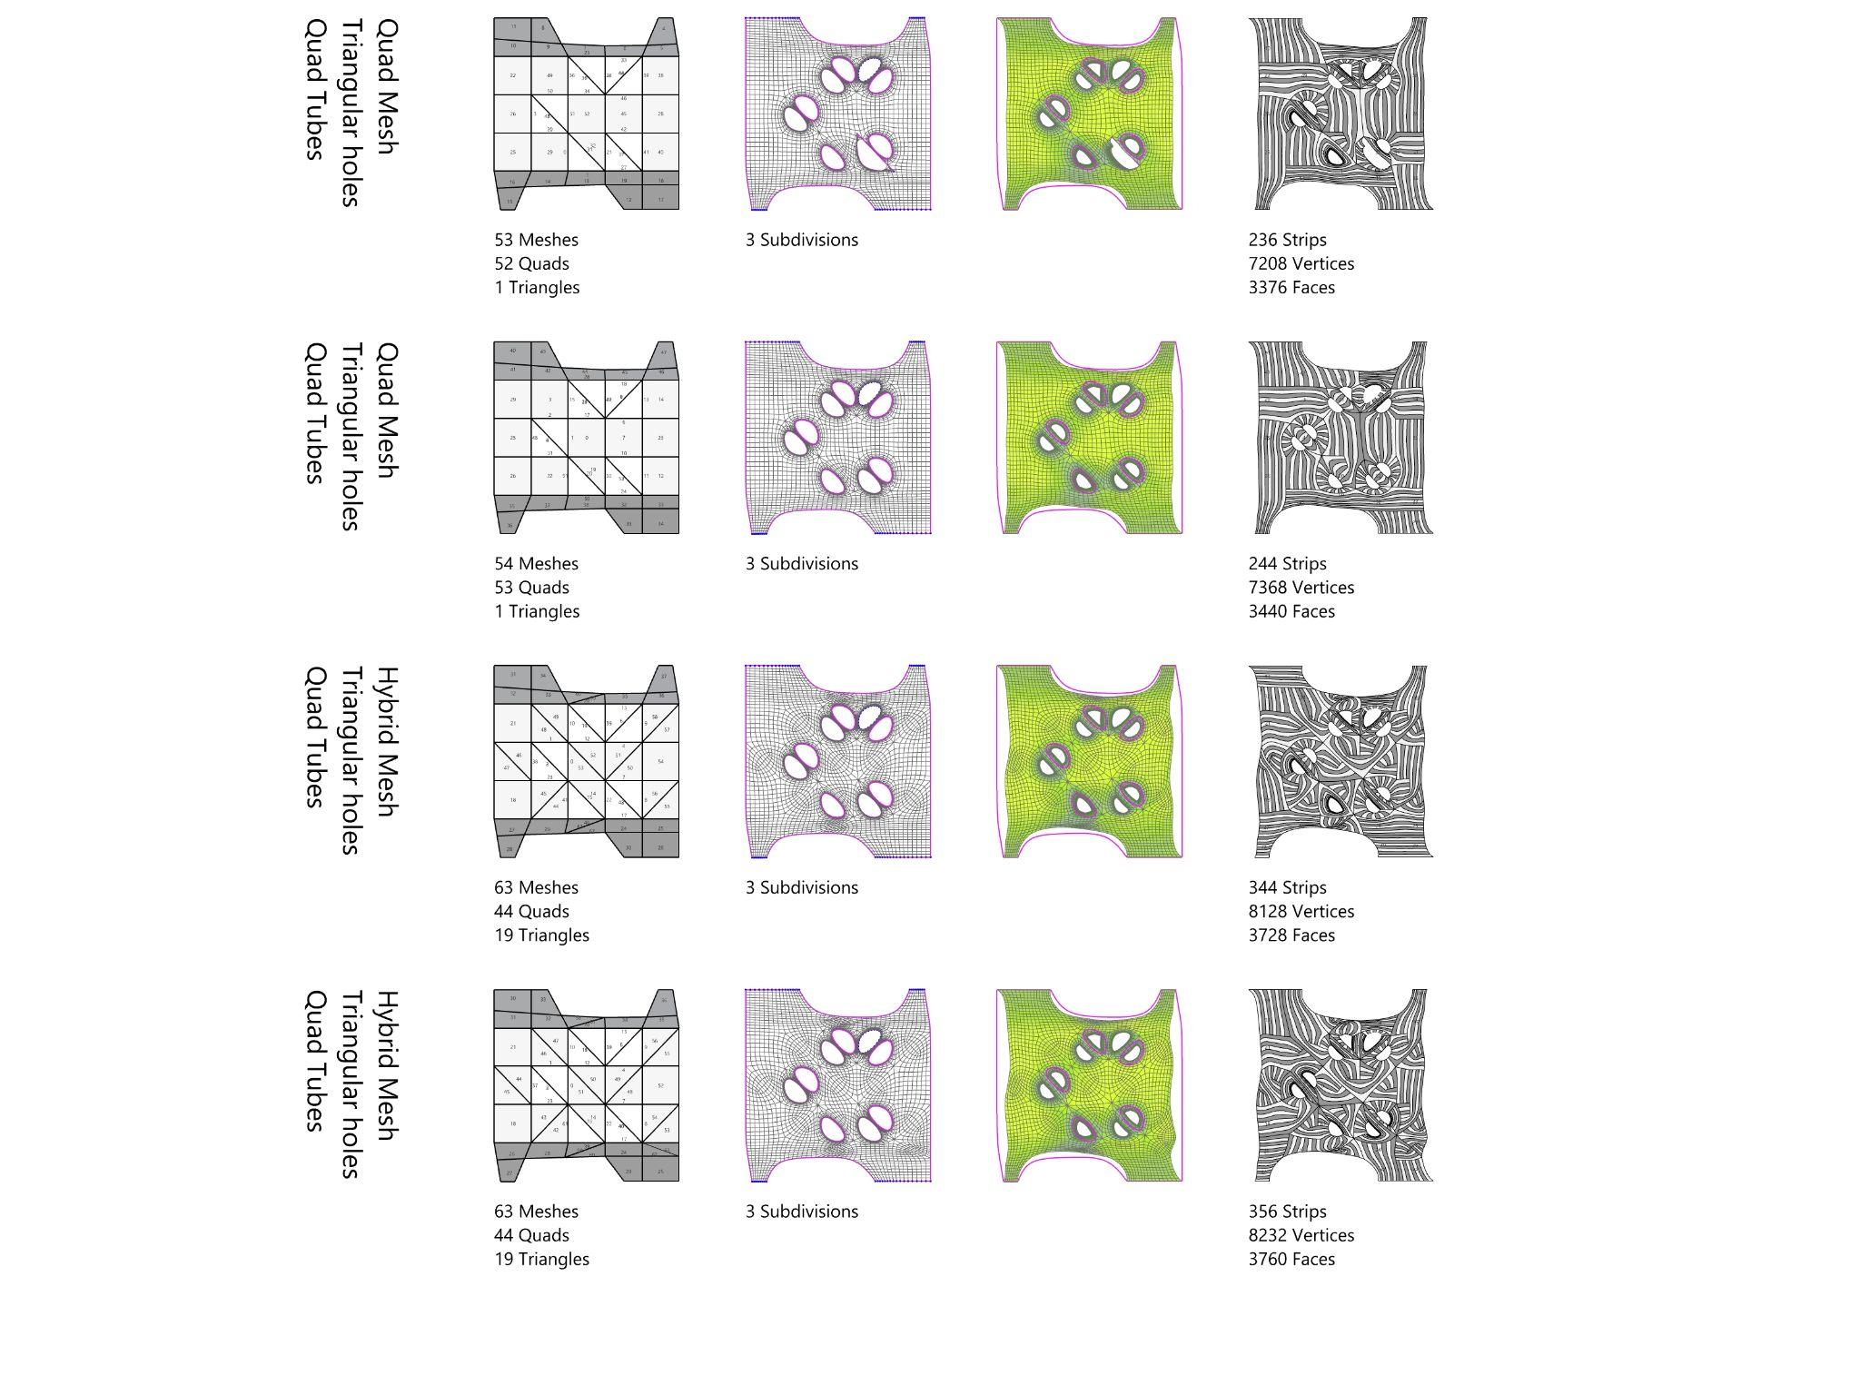
Relaxed Mesh with Innies & Outies
Mesh Orientation Study

Slide 15
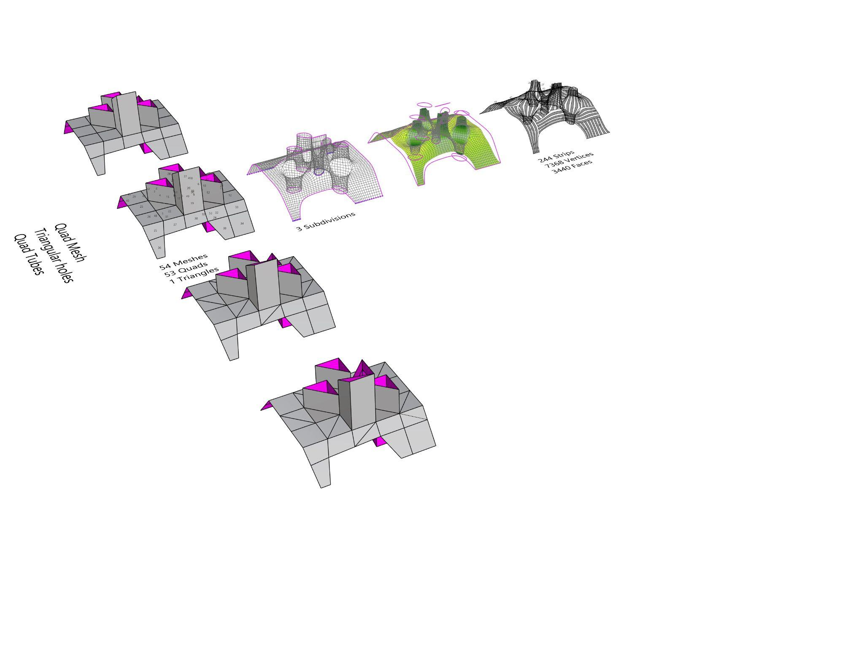
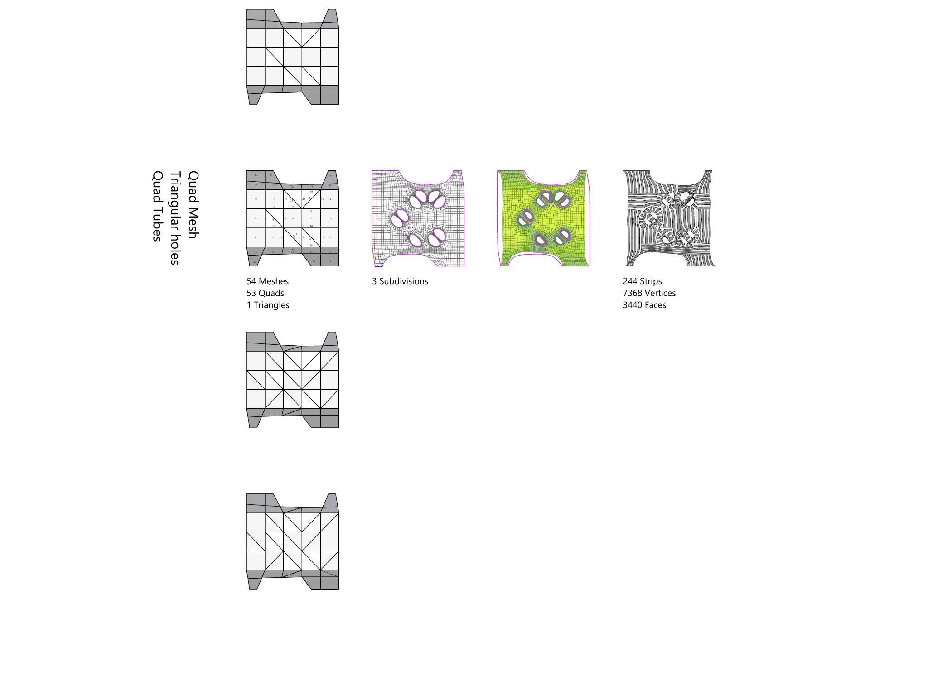
Relaxed Mesh with Innies & Outies
Selection based on desired mesh orientation and tessellation

Slide 16
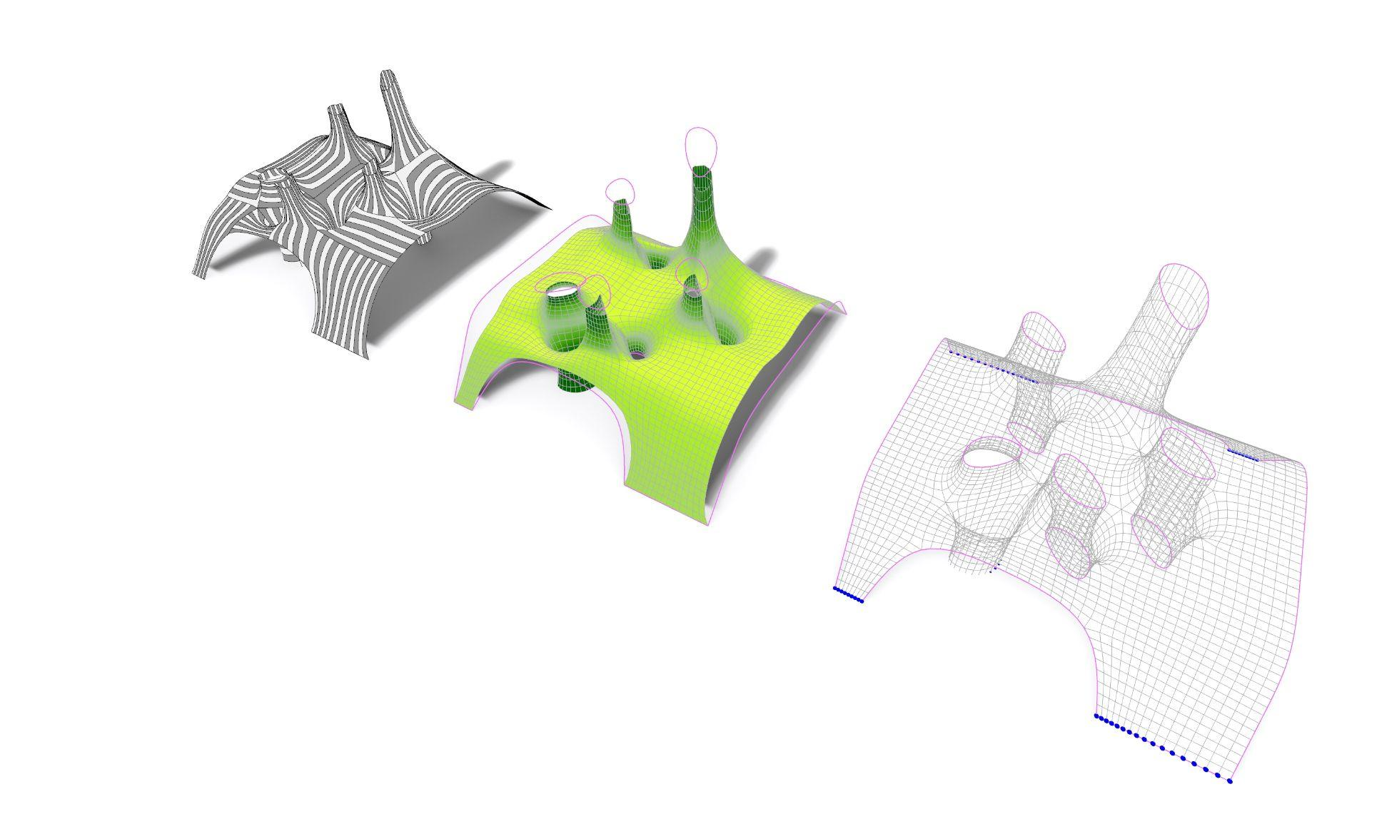
Relaxed Mesh with Innies & Outies
Triangulation Study

Slide 17
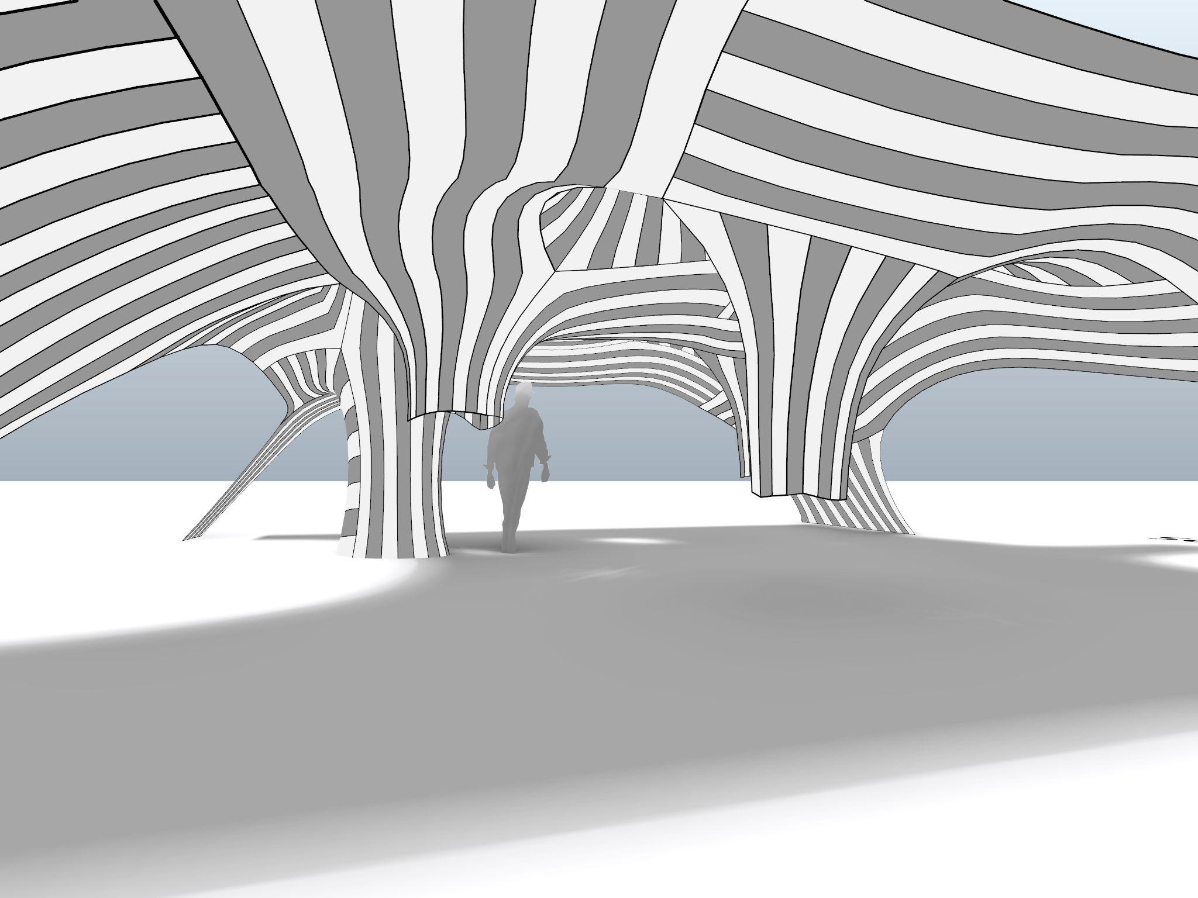
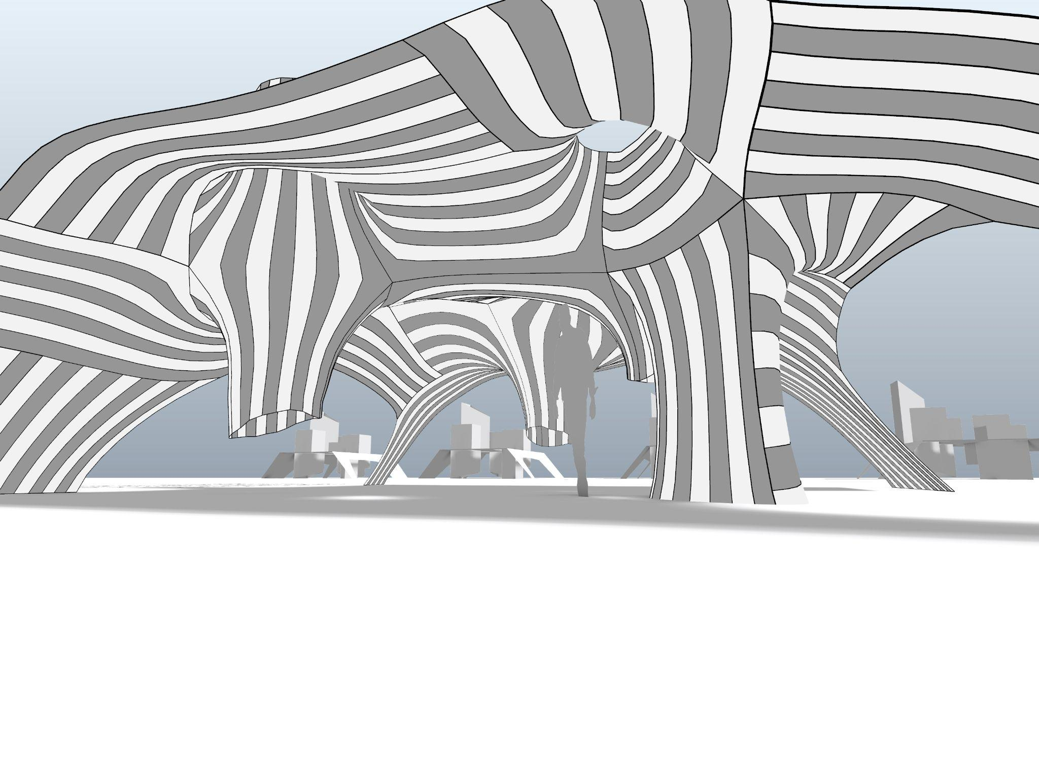
Relaxed Mesh with Innies & Outies
Abstract of pavilion

Slide 18
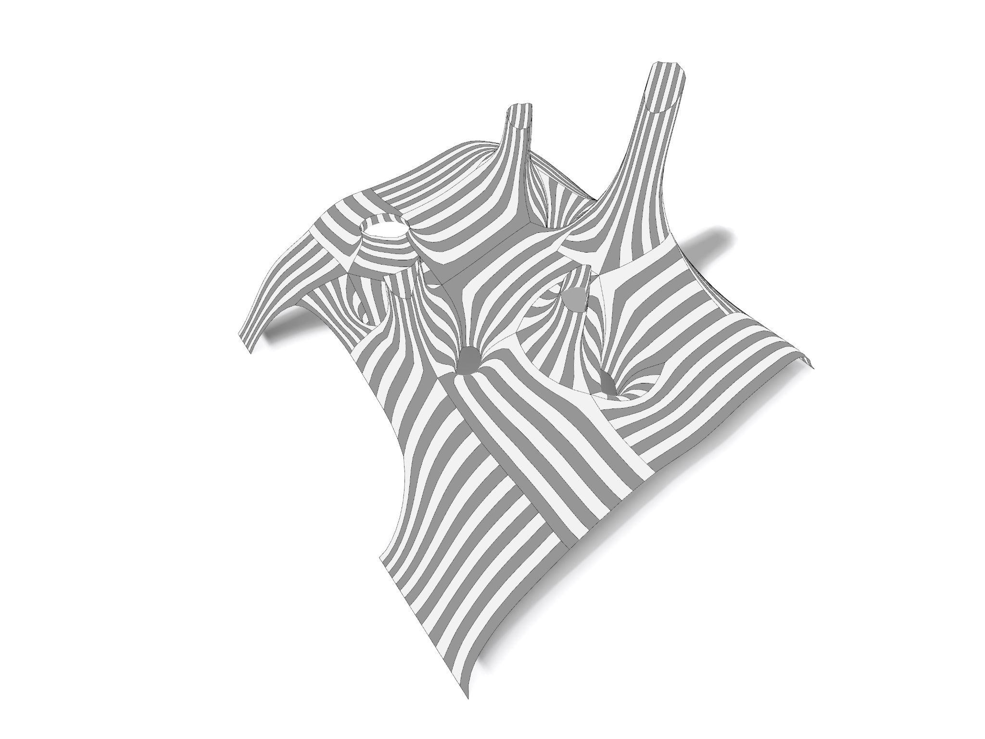
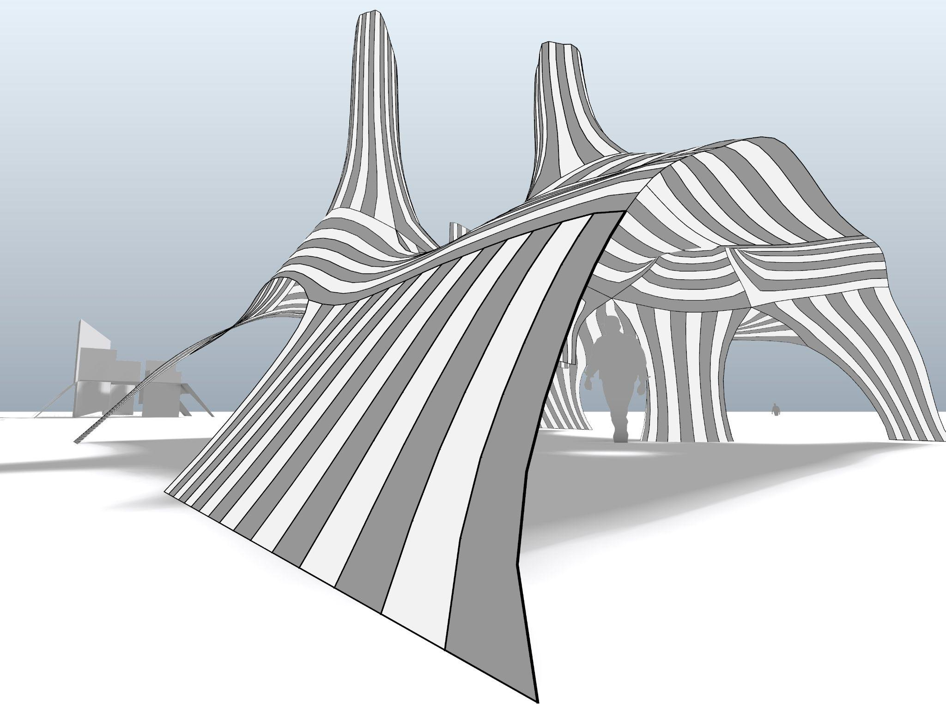
Relaxed Mesh with Innies & Outies
Abstract of pavilion

Slide 19
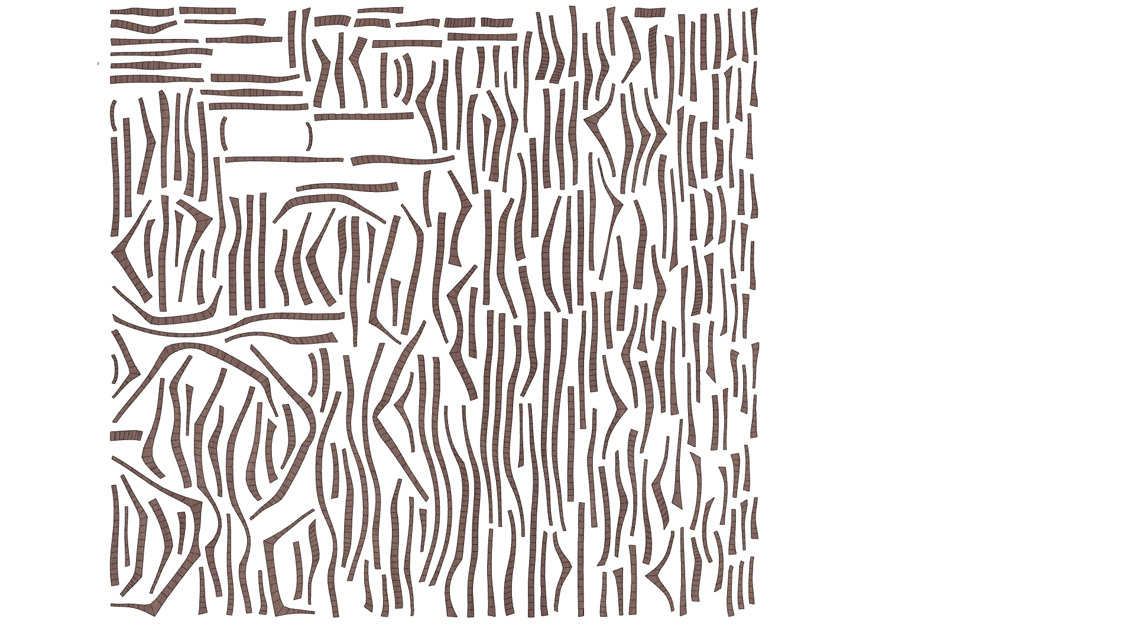
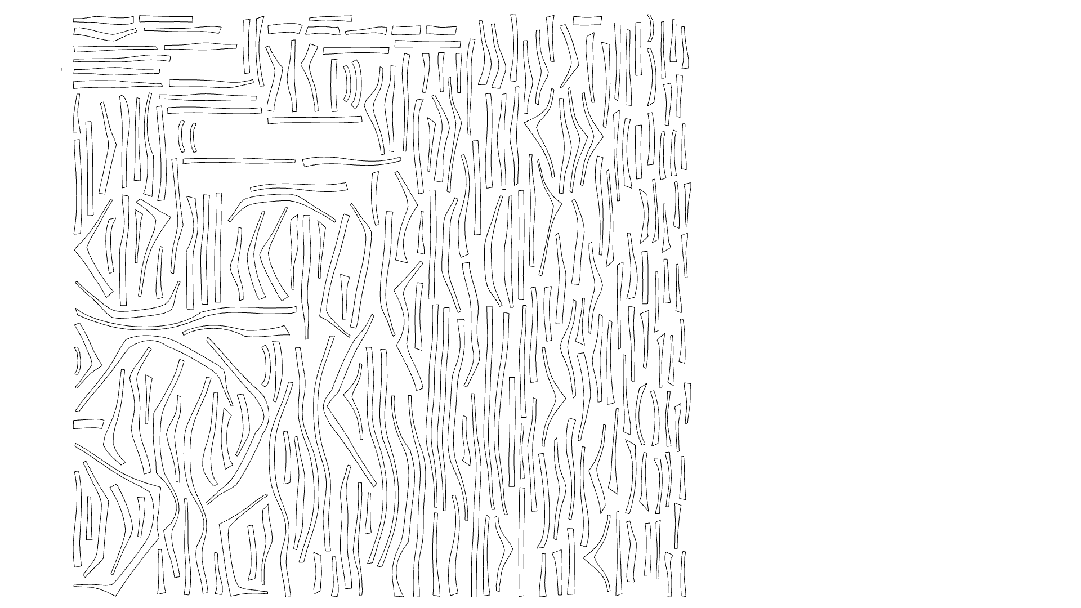
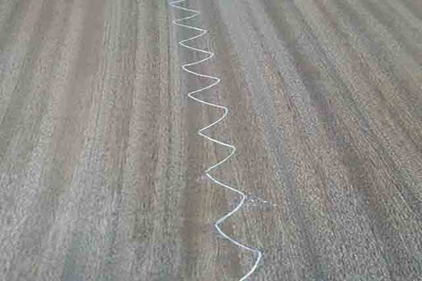
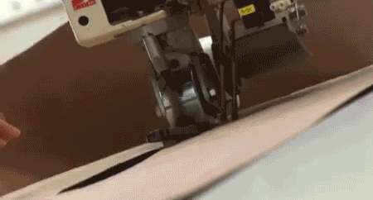
Fabrication Strategy
Veneer Stitching

Slide 20
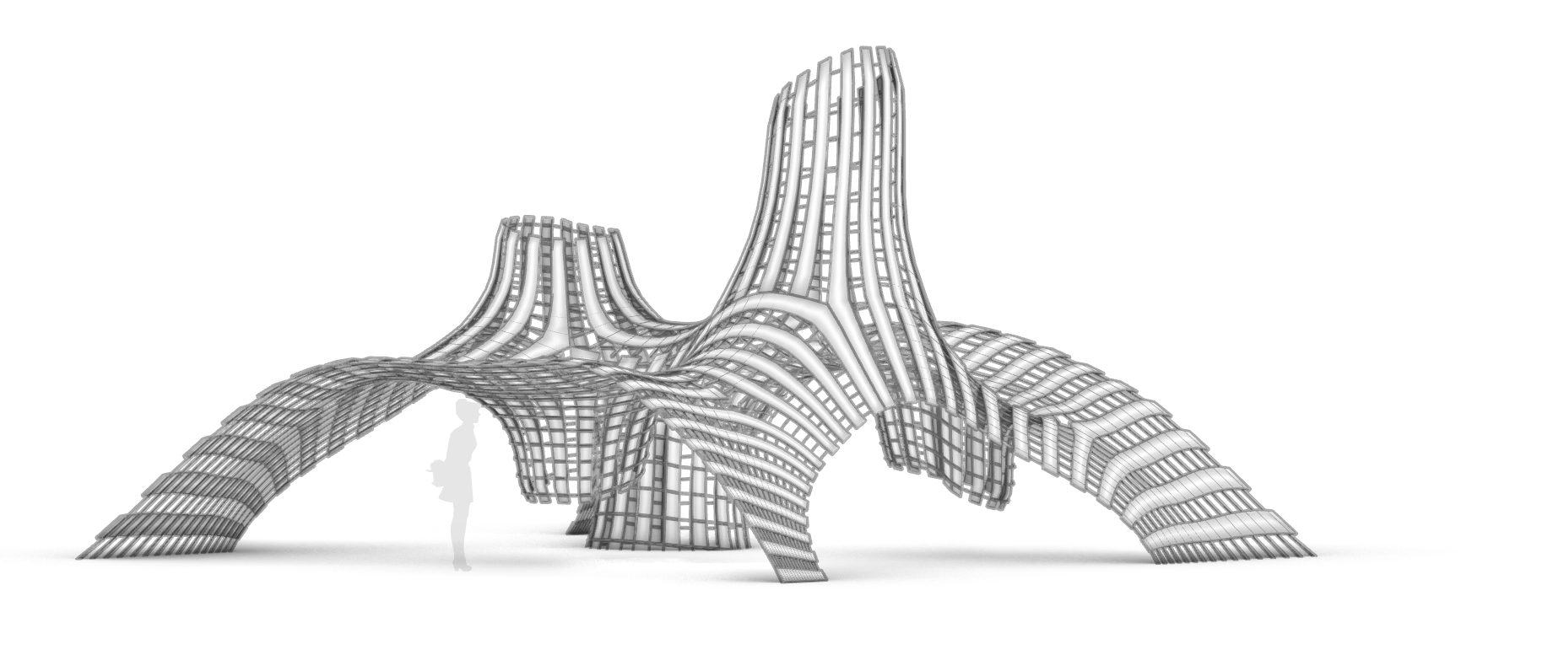
Relaxed Mesh with Innies & Outies
Pavilion Construction

Slide 21
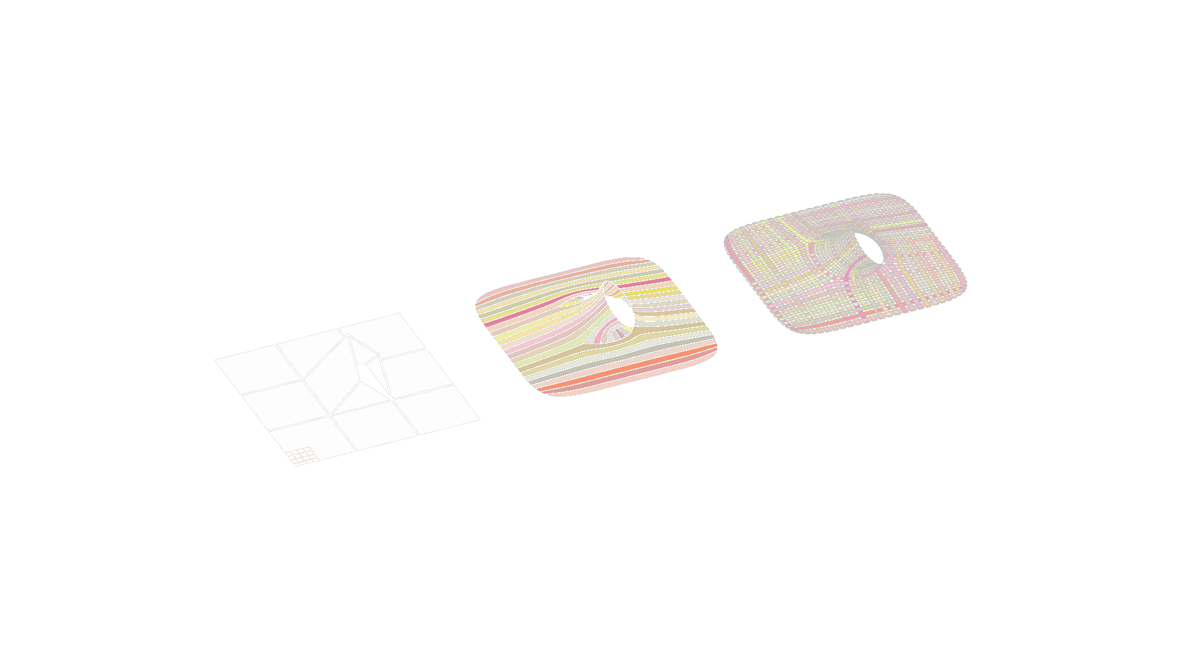
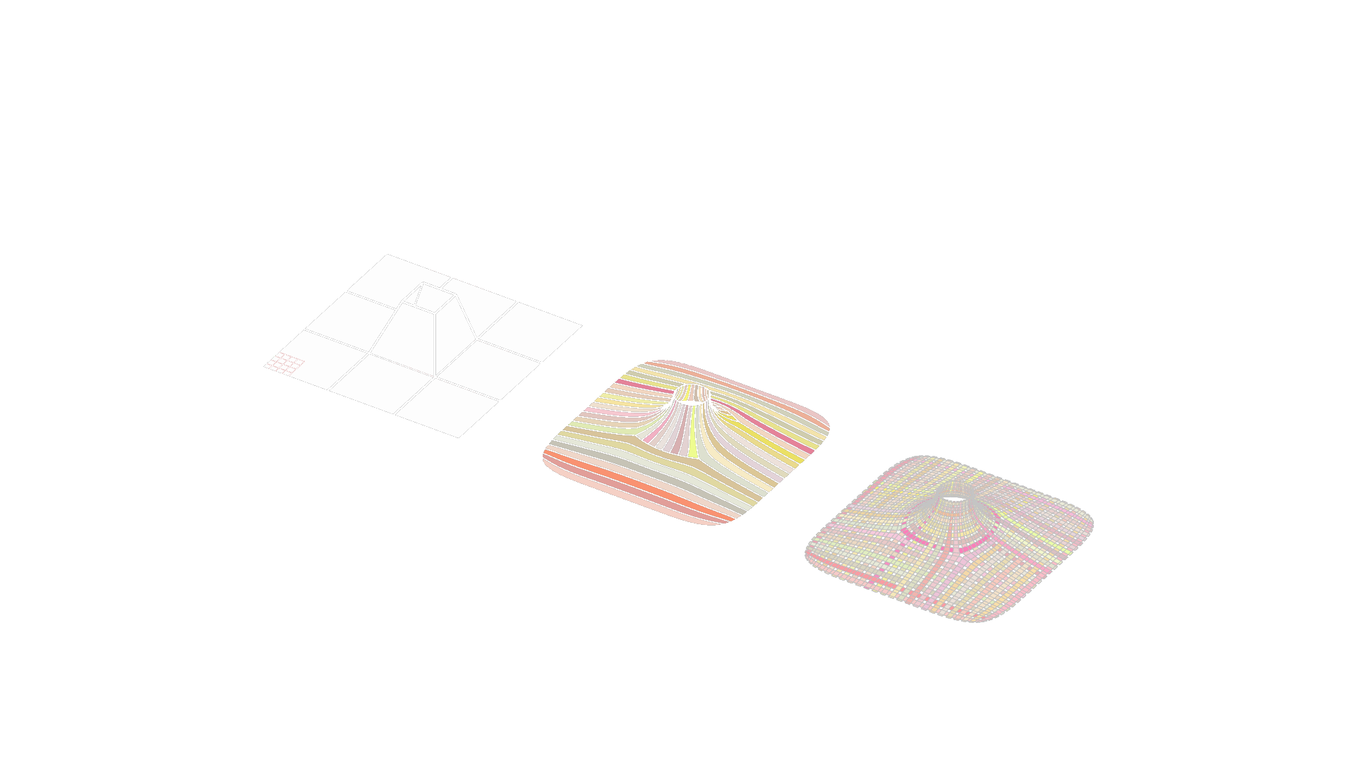
Single Openings, 3x3 Grid

Slide 22
1 Outie

Slide 23
1 Innie, 1 Outie,
Neighboring tri openings

Slide 24
2 Innie, 1 Outie, Neighboring quad openings

Slide 25
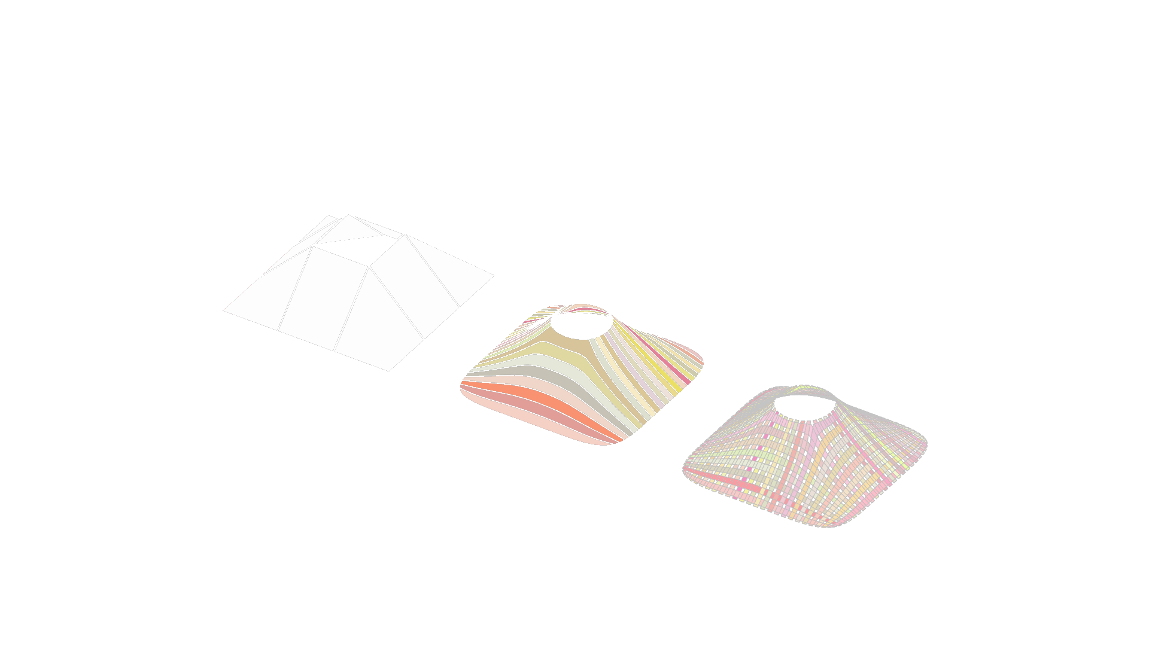


Single Openings, 3x3 Grid

